Slide 1
no more usb? FireWire Security
what’s wrong with FireWire?
Notes:
This presentation demonstrates the new capabilities of PowerPoint and it is best viewed in Slide Show. These slides are designed to give you great ideas for the presentations you’ll create in PowerPoint 2011!
For more sample templates, click the File menu, and then click New From Template. Under Templates, click Presentations.

Slide 2


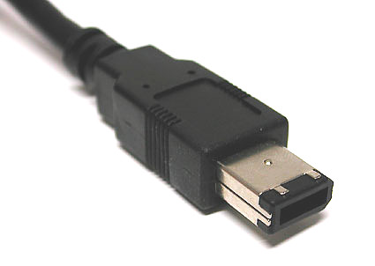
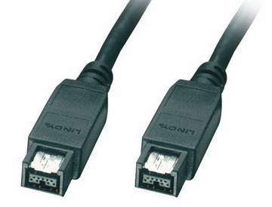
What is FireWire?

Slide 3
USB

Slide 4
FireWire

Slide 5

Differences between USB and FireWire
FireWire:
- IEEE 1394
- “Peer-to-Peer” architecture
- 63 possible devices
- 400 Mbps (FireWire 400)
- Less common
USB:
- Ajay Bhatt
“Master-Slave” architecture
127 possible devices
480 Mbps (USB 2.0)
Highly used

Slide 6
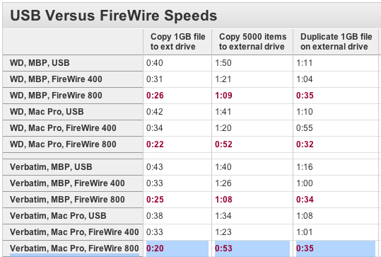
simple speed test from MacWorld.com

Slide 7


What’s the problem?
so it’s fast, but

Slide 8

Possible Risks of Using FireWire
bypass operating systems authentication (winlockpwn)
forensic memory imaging
Security problems
mapping from FireWire to device physical memory is via hardware
recovery of passwords and crypto keys from memory
dropping of trojans

Slide 9


winlockpwn – Adam Boileau
Wrote winlockpwn in 2008
Affected Windows XP computers

Slide 10
Why use FireWire?
the question remains…

Slide 11





Questions?
What’s Your Message?

